Slide 1





Zero-Reference Deep Curve Estimation for Low-Light Image Enhancement
https://li-chongyi.github.io/Proj_Zero-DCE.html
Chunle Guo^{1,2}, Chongyi Li², Jichang Guo¹,
Chen Change Loy³, Junhui Hou², Sam Kwong², Runming Cong⁴
¹Tianjin University, ²City University of Hong Kong, ³Nanyang Technological University, ⁴Beijing Jiaotong University

Slide 2


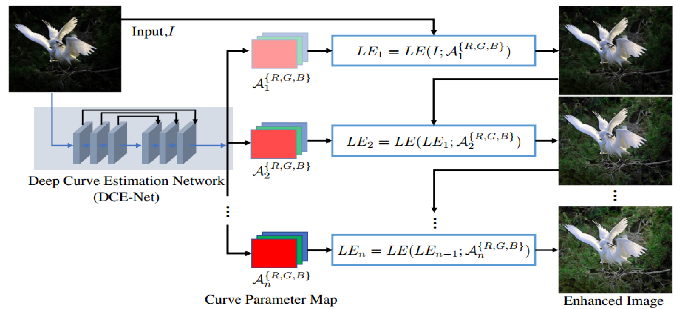
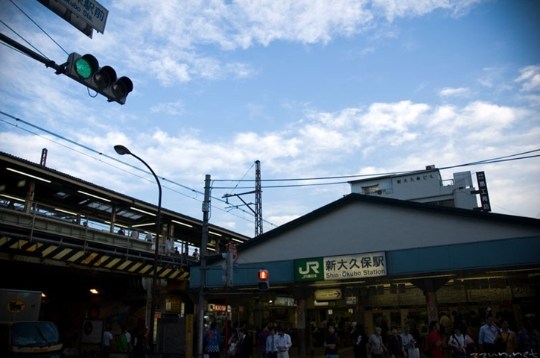

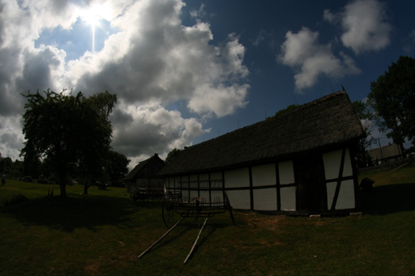
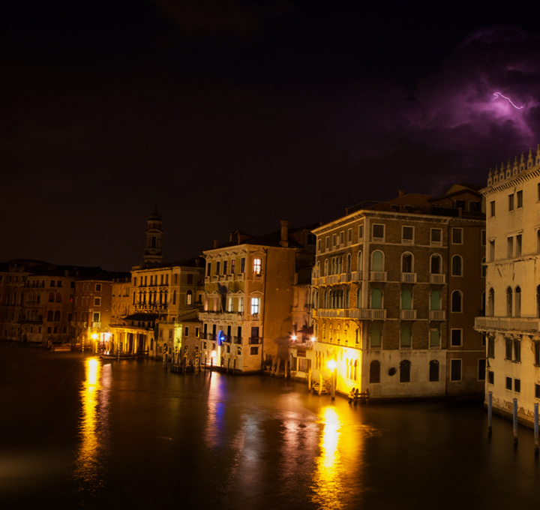
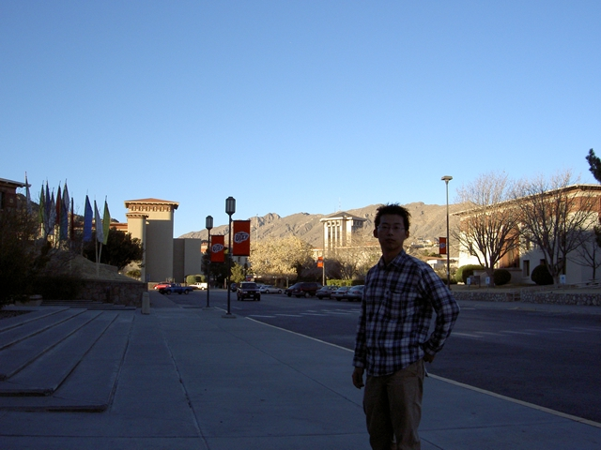
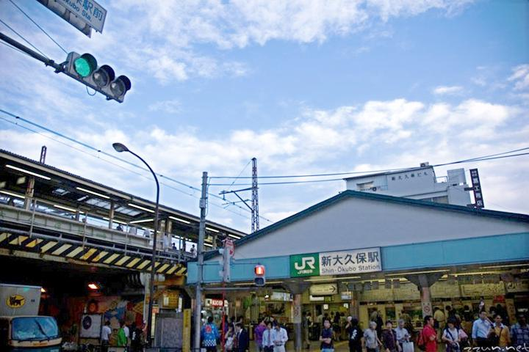
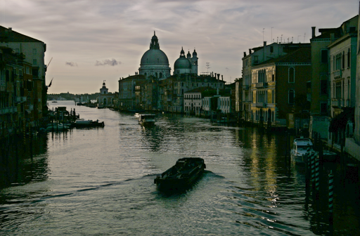
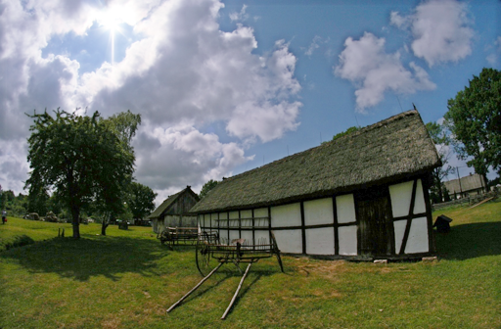
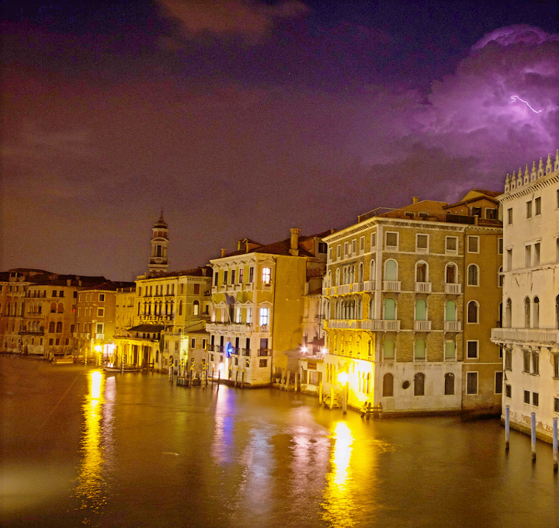
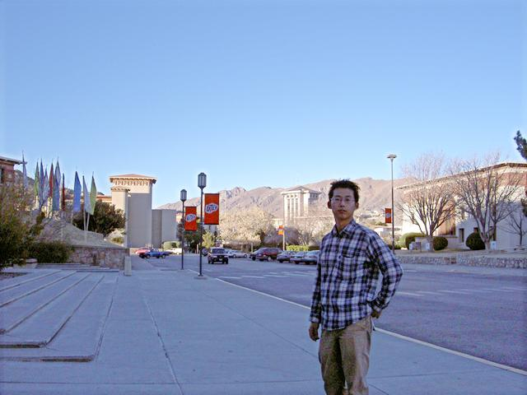
01
Framework
Low-Light
Zero-DCE

Slide 3
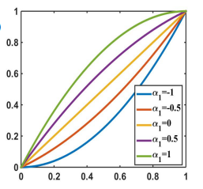
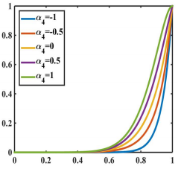
02
LE-Curves
LE-Curves:
Higher-Order Curve:
Pixel-Wise Curve:
where LE is the enhanced version, I is the input image , α is the trainable curve parameter in the range of [-1,1], n is the number of iteration, and A is the parameter map.

Slide 4
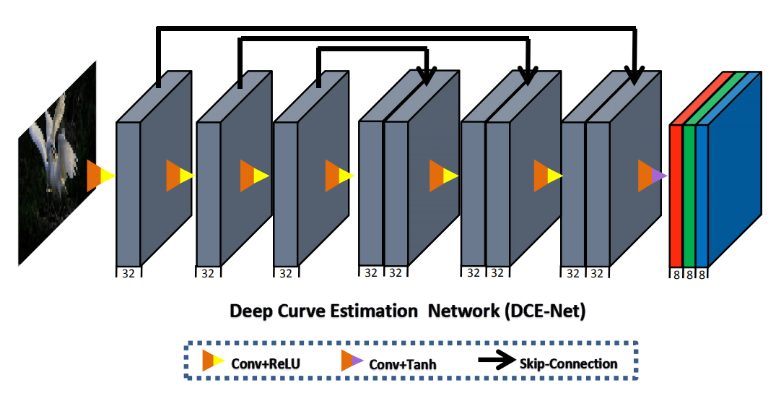
03
DCE-Net
DCE-Net has 79,416 trainable parameters and 5.21G Flops for an input image of size 256×256.

Slide 5
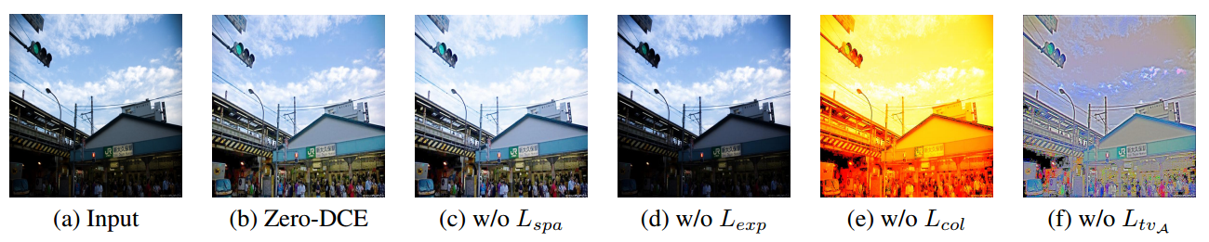
04
Non-Reference Loss Functions
Spatial Consistency Loss:
Exposure Control Loss:
Color Constancy Loss:
Illumination Smoothness Loss:
Total loss:
Ablation study of the contribution of each loss.

